Slide 1
The Impact of Large Language Model Tutors on Undergraduate Learning
Hannah Brown
Advisor: Narges Norouzi, PhD
Spring 2025

Slide 2
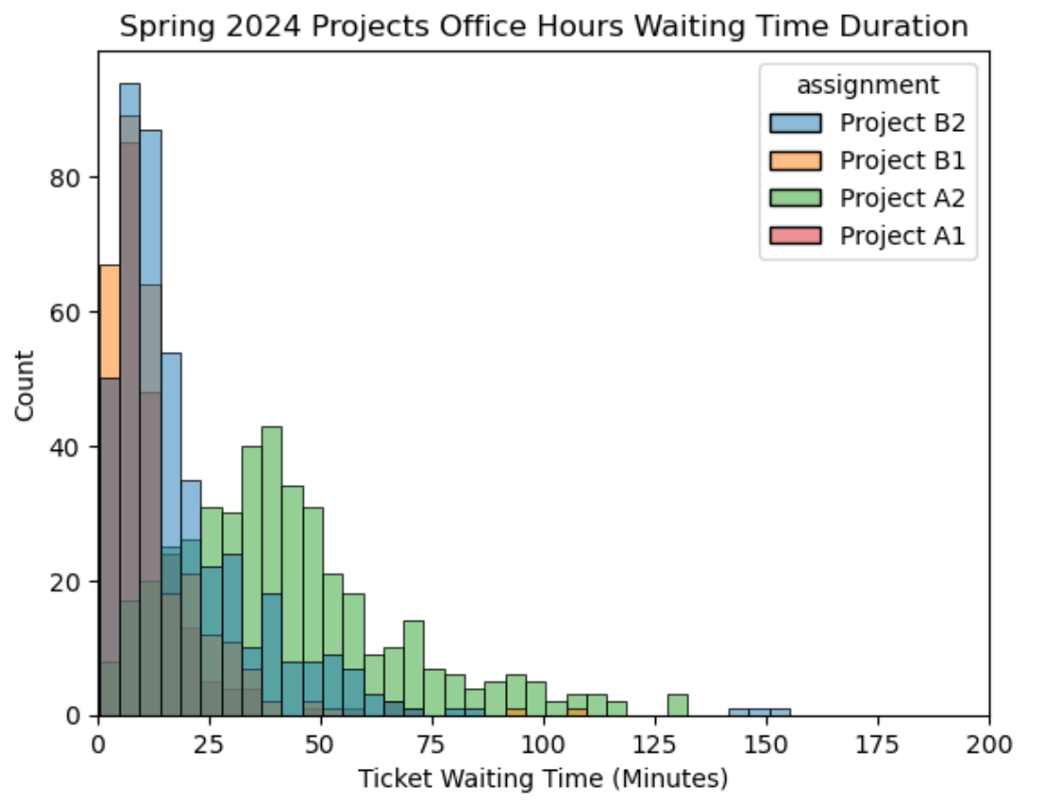
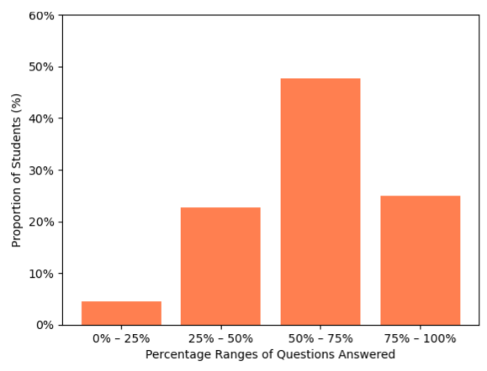
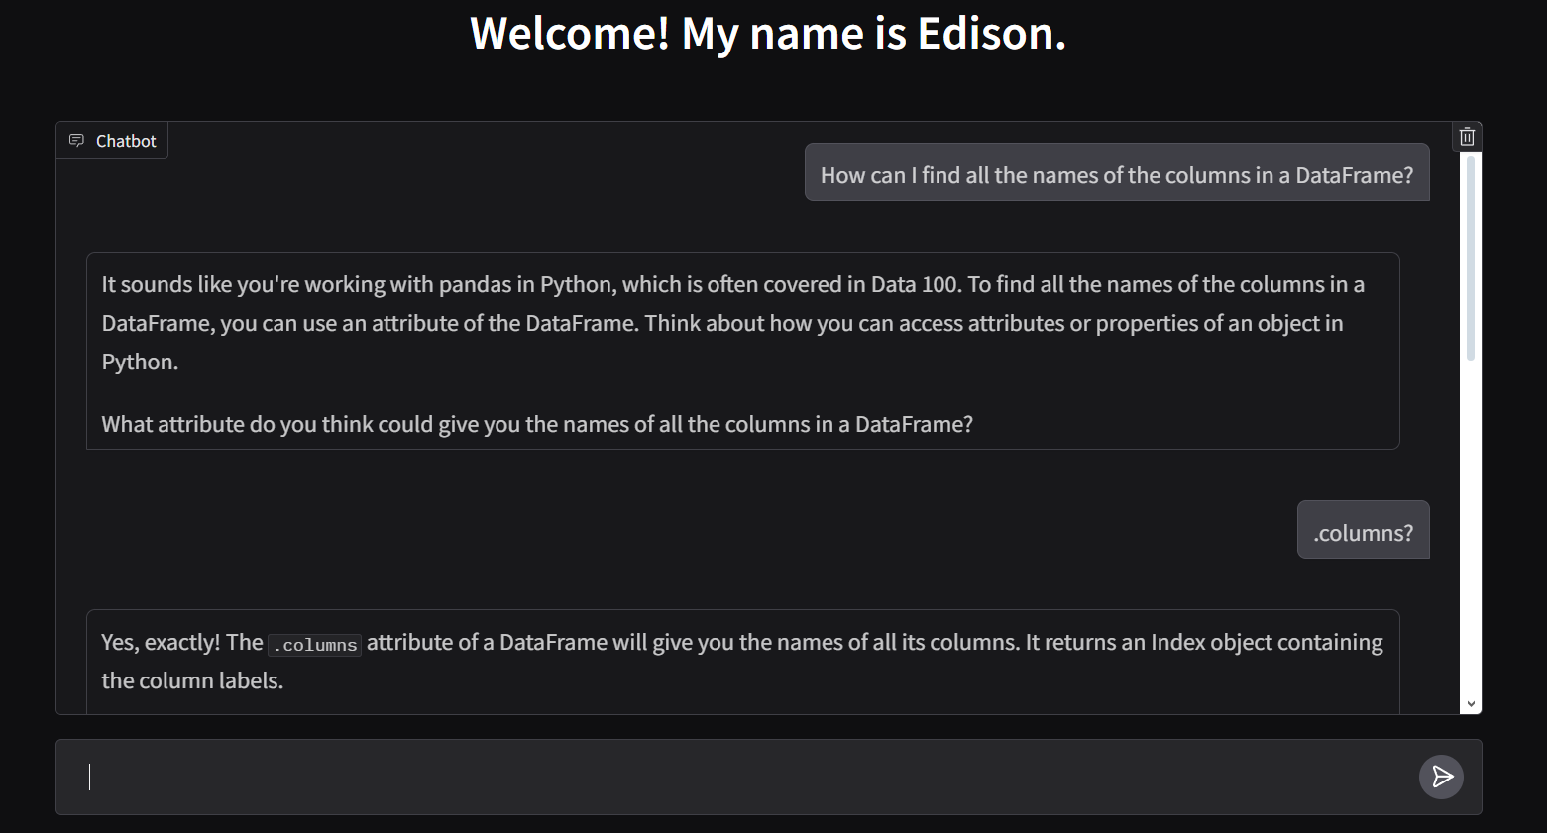
Does AI belong in the classroom? 🤖📝
Students avoid homework shortcuts w/ trained LLMs
Analyzed Data 100 office hours -> LLM tutors help demand in large classes
Surveyed Stat 131A’s usage of LLM tutor, PingPong
Students like the customization & professor moderation
Students dislike dependence on AI -> PingPong helps them learn
Created an interface for Berkeley’s LLM tutor, Edison
Allows for student interaction with the model
Supports tutors to focus on complex queries
LLM tutors promote tutoring access
Stresses the importance of human interaction

